Slide 1

Psychology of memory
10 PreATAR Science

Slide 2
Learning Intentions
Describe the Cognitive Model of Memory
Introduce Psychology Investigation

Slide 3
Success criteria
Define sensory, short-term (working) and long-term memory
Compare the capacity and duration of each
Determine variables for psychology investigation

Slide 4
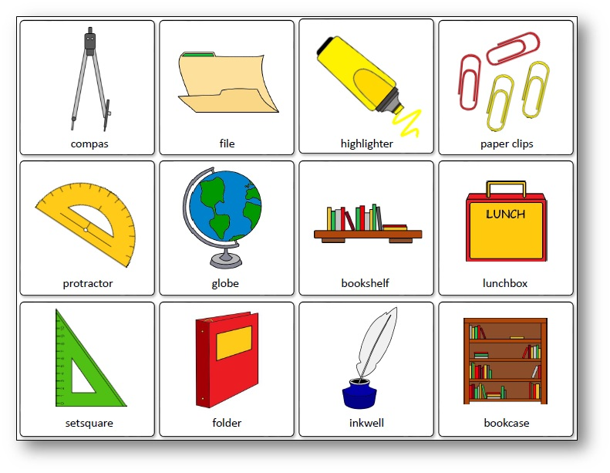
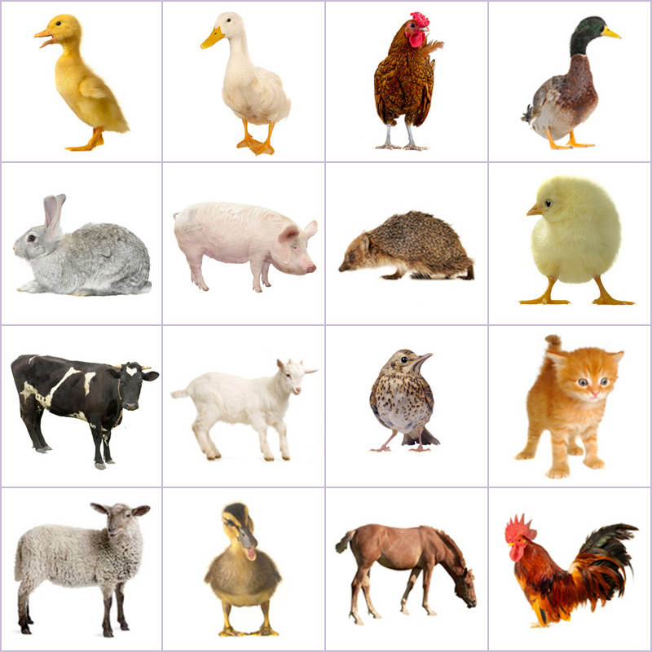
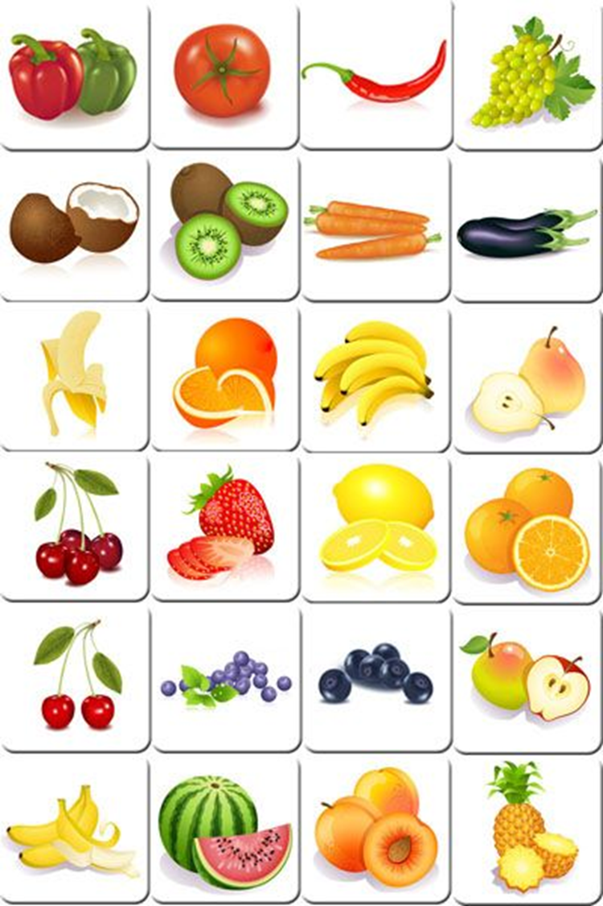
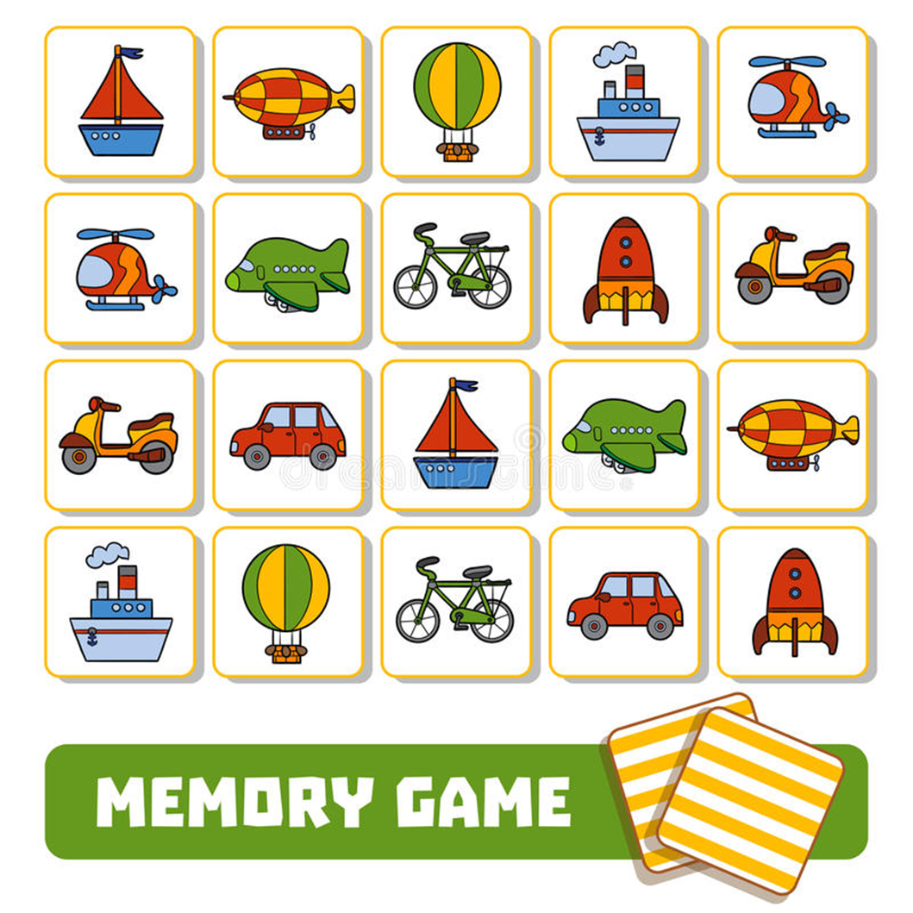
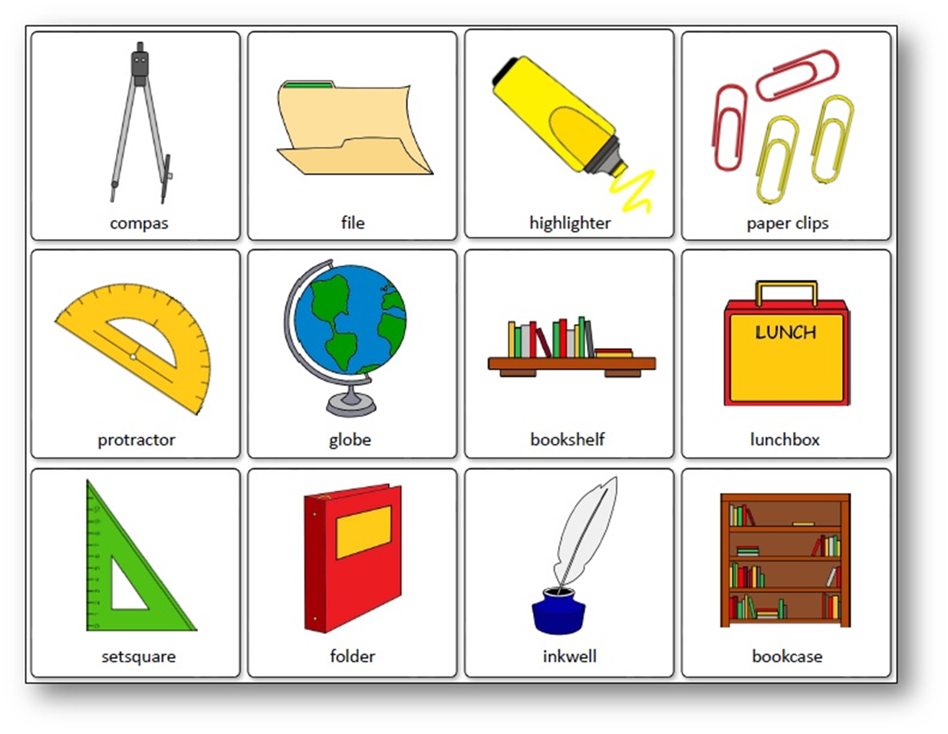
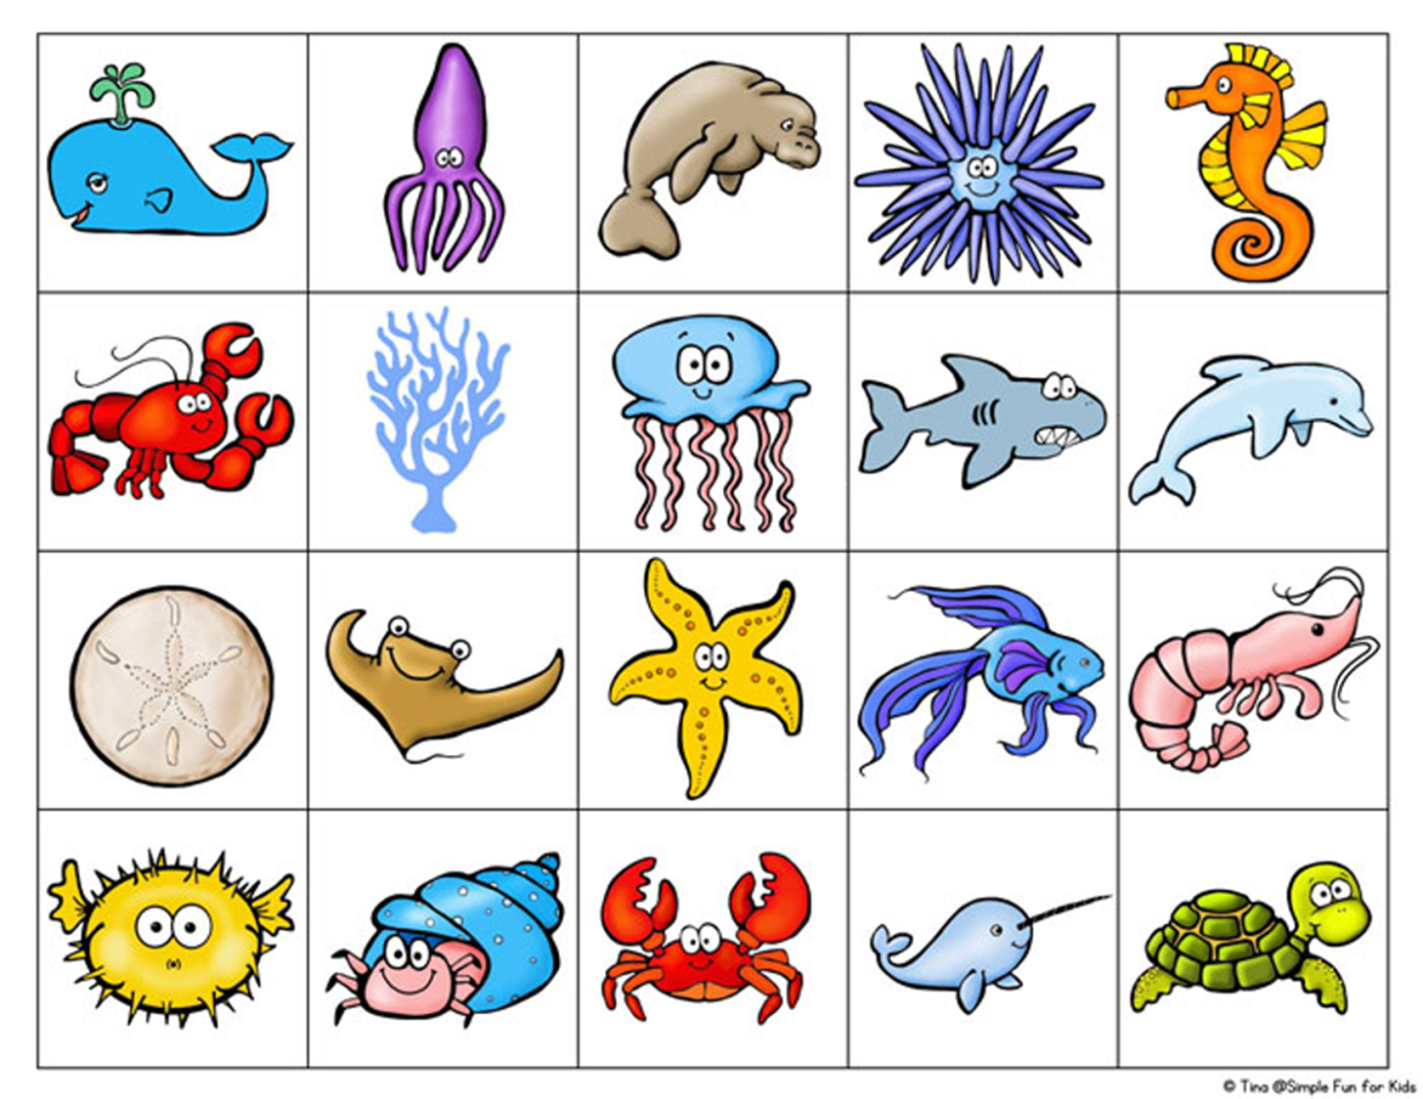

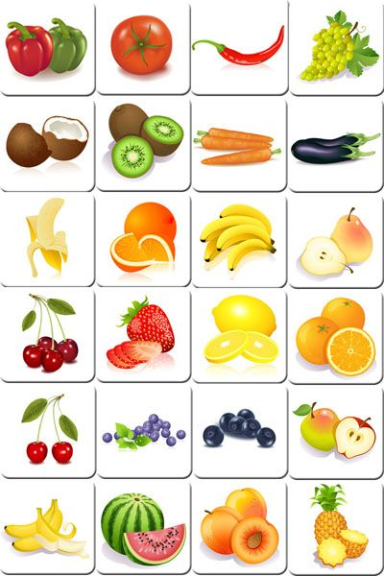

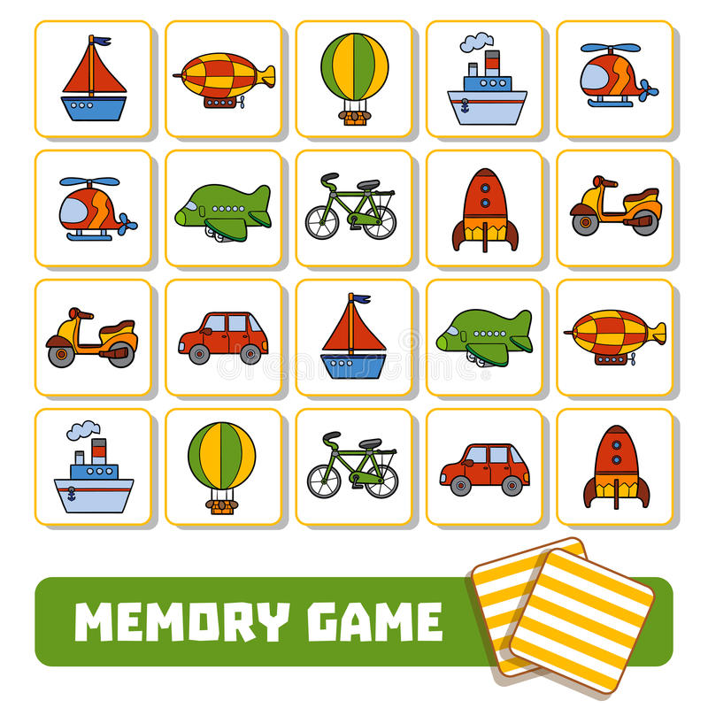
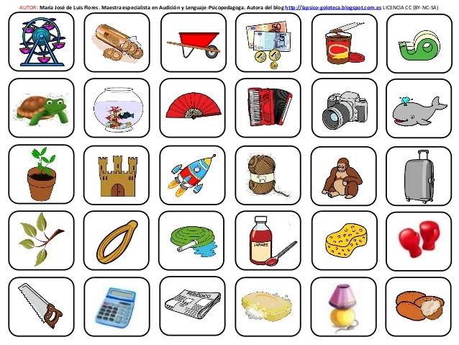



Slide 6


Slide 7
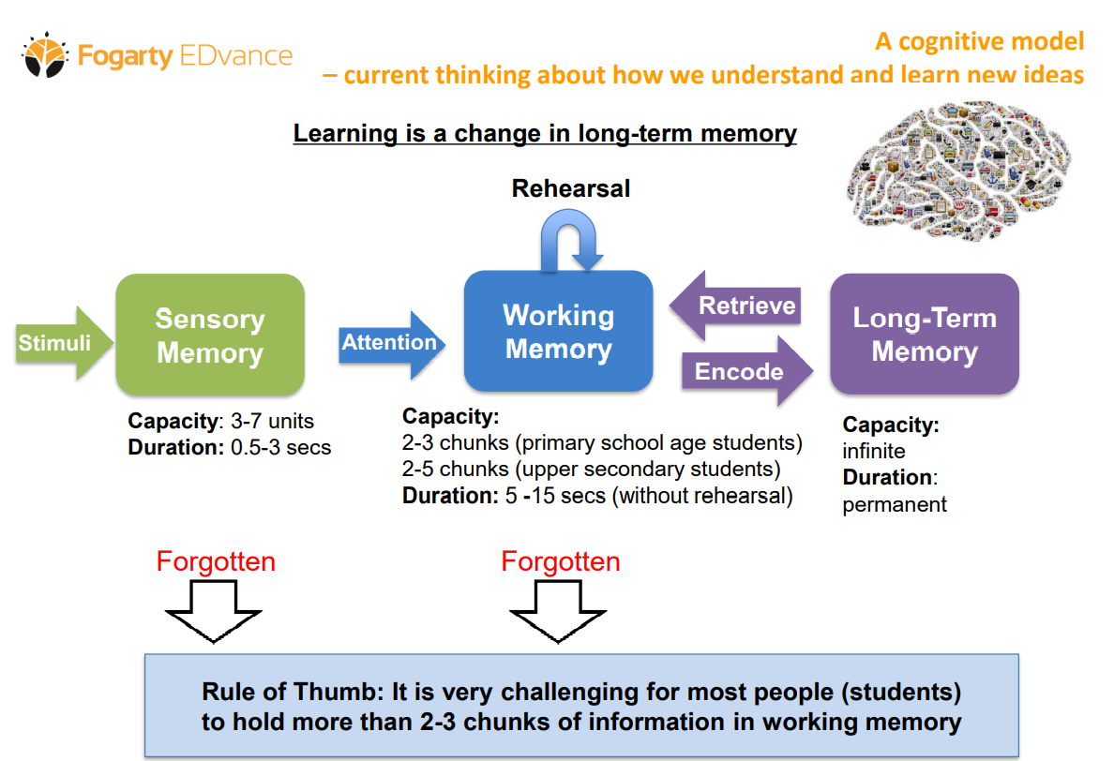
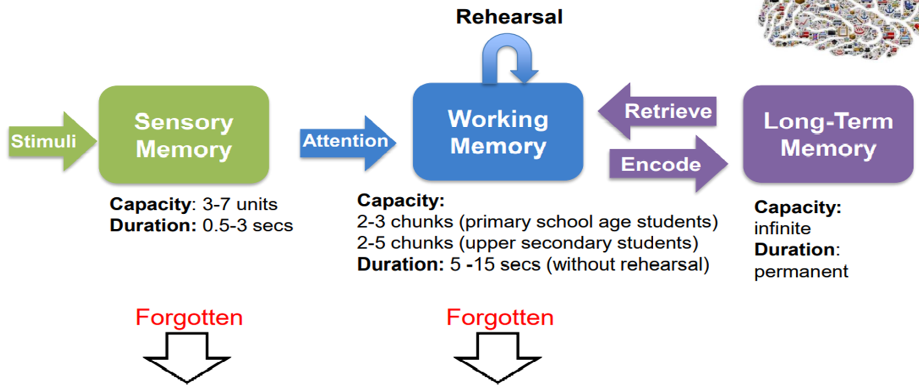
Cognitive Memory Model

Slide 8


Slide 9
Free Memory Test (5 Mins) – Short Term and Long Term - Practical Psychology (practicalpie.com)

Slide 10
Investigation: List variables which relate to short and long term memory and use them to determine a research question to investigate
Does testing someone on a topic make them remember more than just studying?
Does chunking help you to remember more information?
What is the ideal number of digits to remember for short term working memory?
Do we remember visual stimuli better than auditory stimuli?
Does distraction affect your results on the Nback test?

